Slide 1
SMART GLOVE
for Gesture-to-Speech Communication
AI-based assistive wearable for mutism/deaf users
George Ishak
Eng. Ahmad Trad

Slide 2
62% to 77% of Deaf individuals experience severe communication difficulties when interacting with hearing people, such as medical professionals or the general public.
“
“

Slide 3
Getting to know the glove
Introduction​ and objectives
​System Overview
Architecture Diagram
Hardware Components
Data Stream
AI Model
Trained Gestures
Model Results

Slide 4
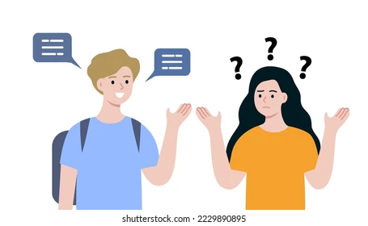

Introduction And Objective
People with speech or hearing difficulties struggle to communicate or waiting for someone to understand gestures can be slow.
Build a wearable glove that detects finger gestures and converts them into spoken words designed for people with mutism, speech difficulties, temporary loss of speech, communication challenges

Slide 5



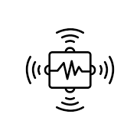
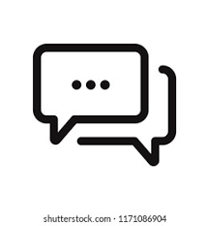
System Overview
Flex Sensors
Arduino nano 33 ble rev2
Ai gesture prediction
Glove sensors
Speech / TExt output
Bendable electronic strips that act as variable resistors
An advanced, 3.3V miniature development board.
Technology that uses machine learning to anticipate and interpret human body movements
Device equipped with built-in electronic sensors that transmit data about the movement
How computers communicate: either by reading words aloud or typing them

Slide 6
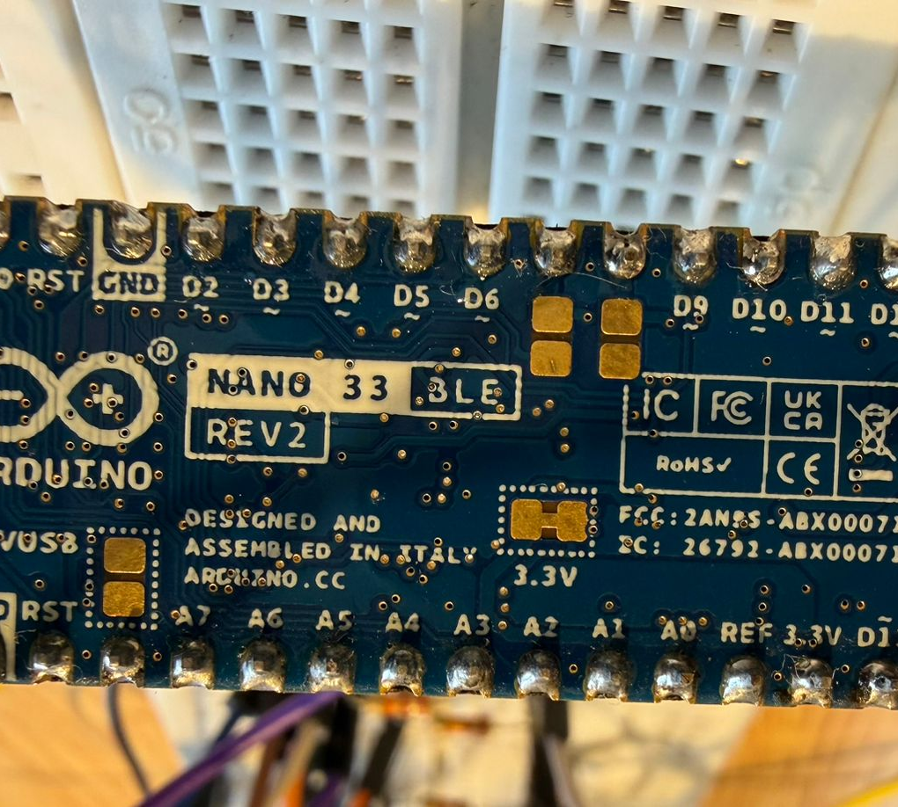
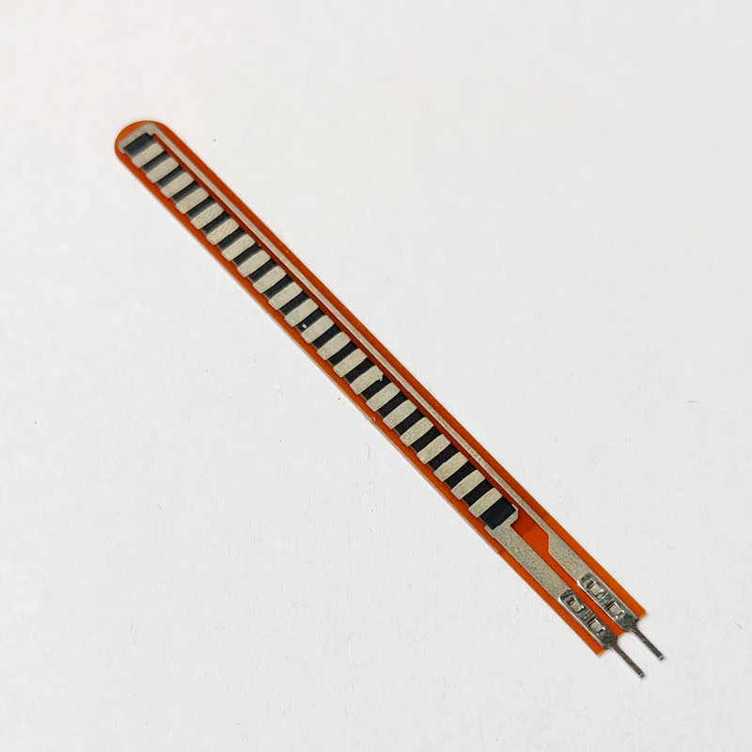
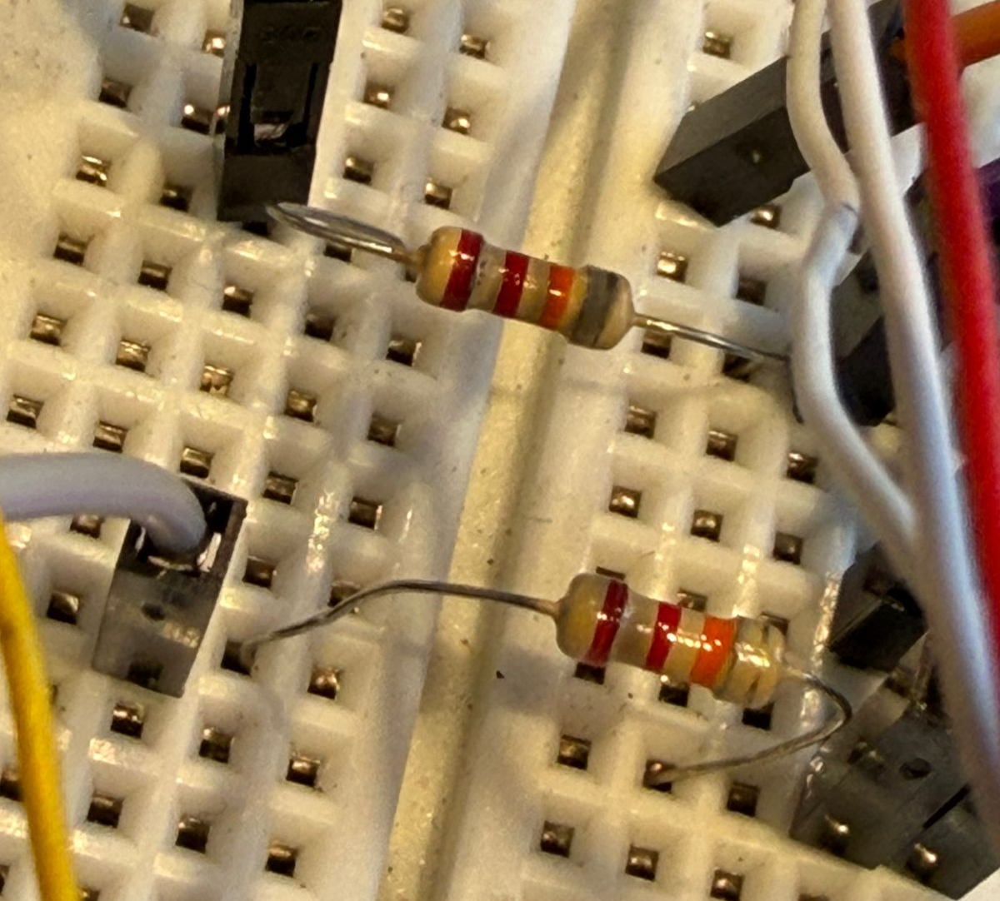
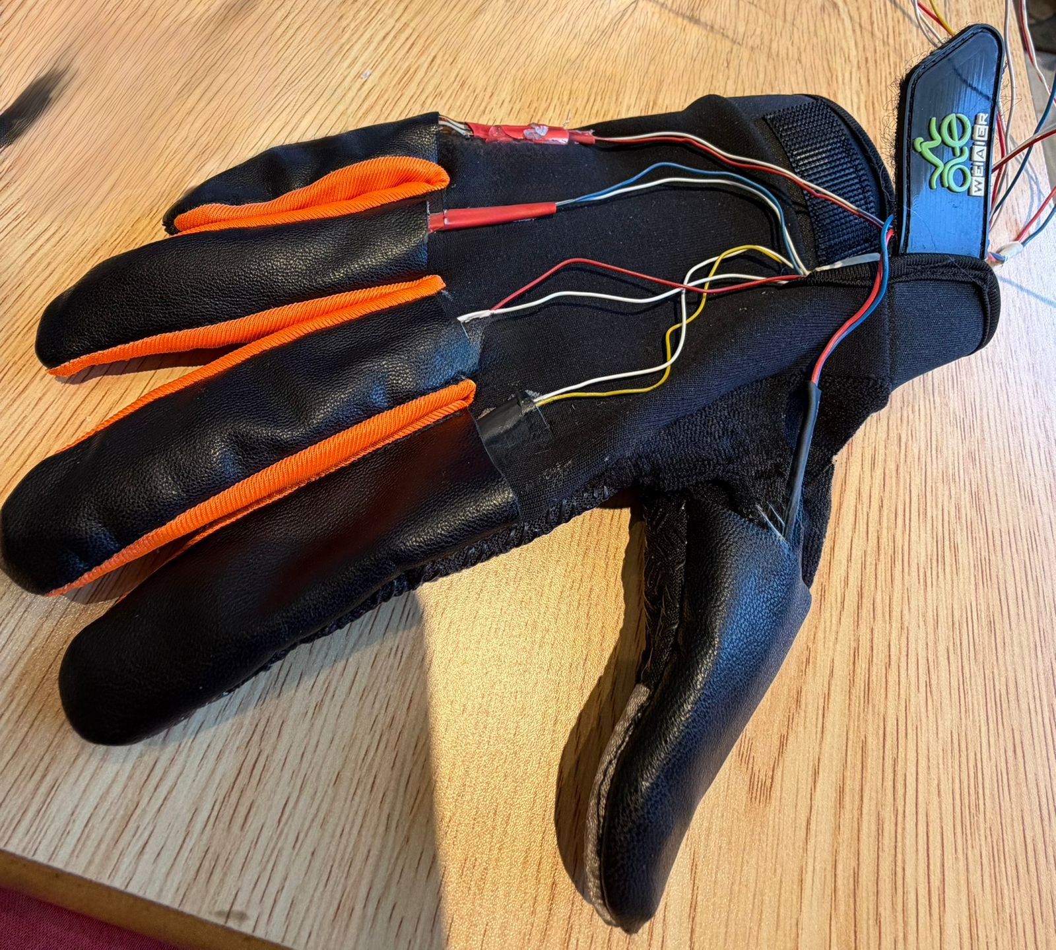
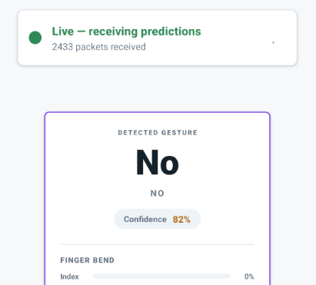
Hardware components
Arduino nano 33 ble rev 2
5 flex sensors
Resistors
glove
Mobile device

Slide 7
Finger Sensor Mapping and data stream
Index = A0 / Middle = A1/ Ring = A2 / Pinky = A3 / Thumb = A4
Arduino sends clean 5-value data
index, middle, ring, pinky, thumb
Example:
100,0,0,0,0 = Index active
0,100,0,0,0 = Middle active

Slide 8
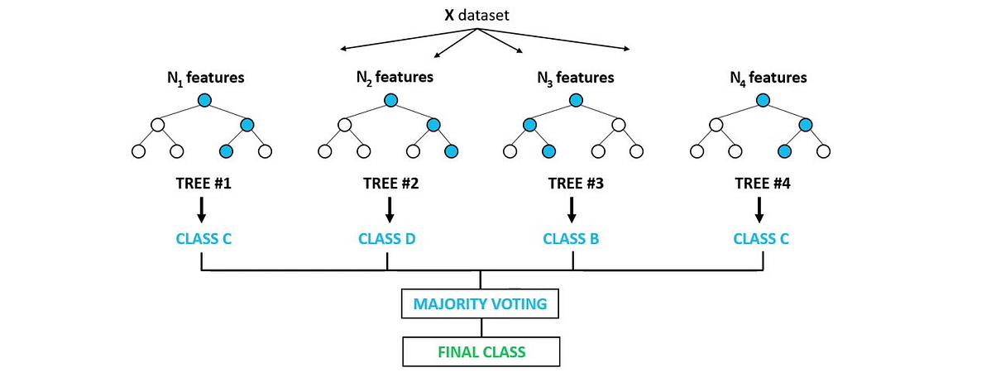
Ai model
The project uses a Random Forest Classifier to recognize gestures from finger sensor values.
It was chosen because it works well with numerical sensor data and noisy prototype readings.

Slide 9
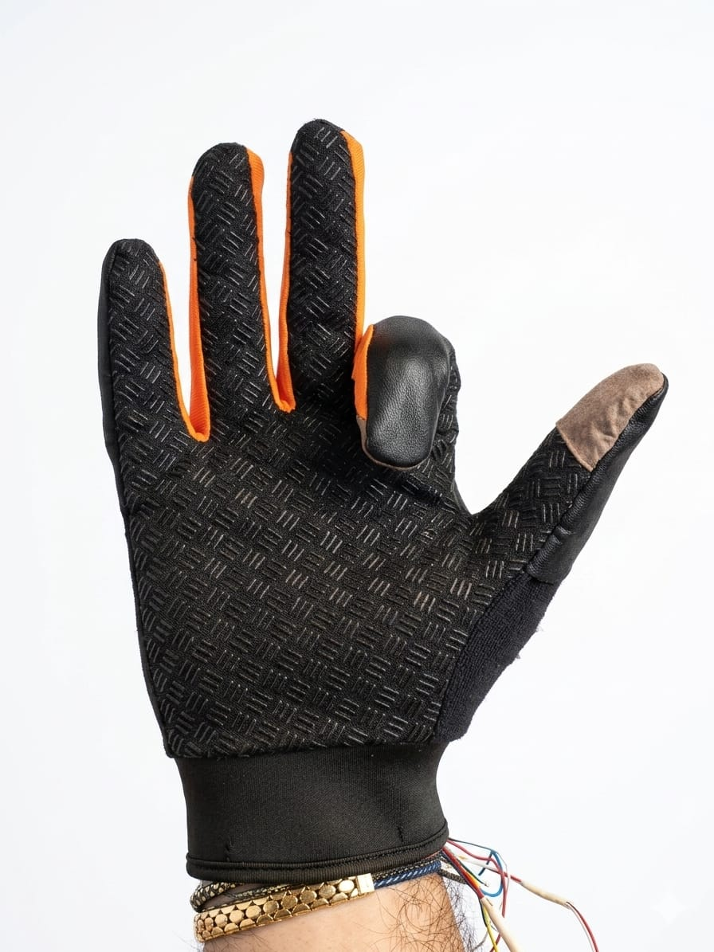
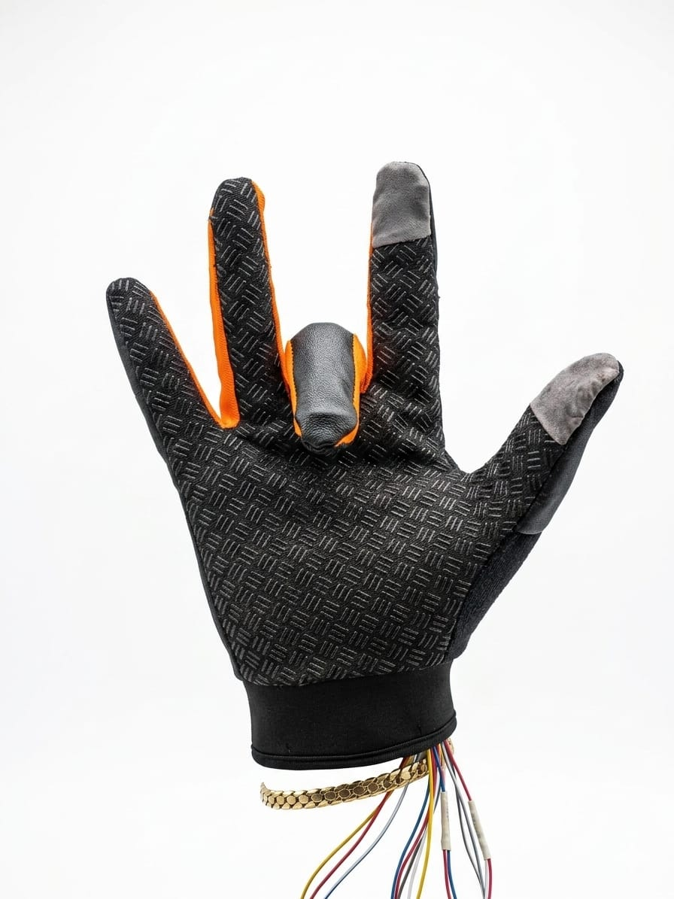
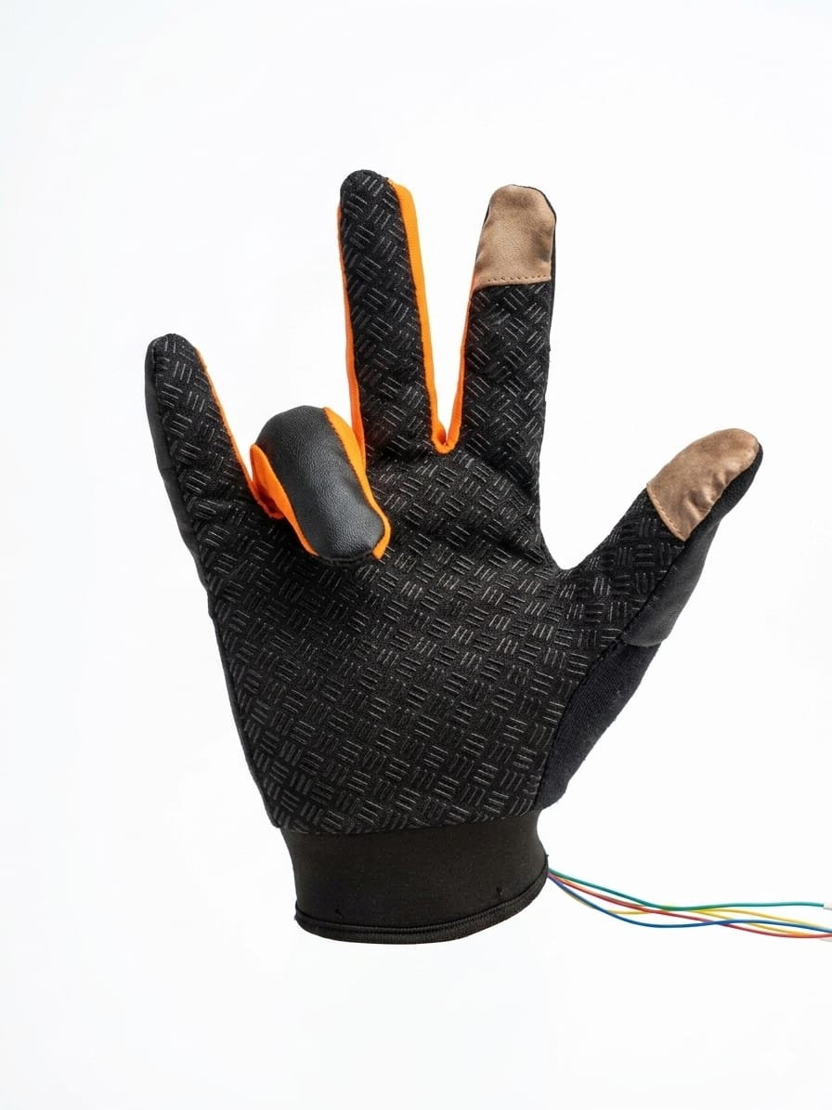
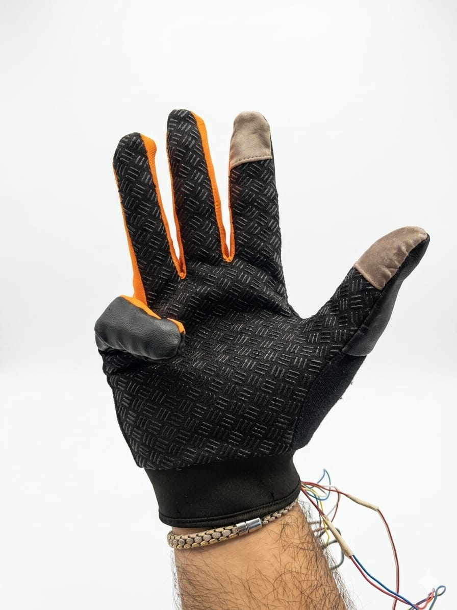
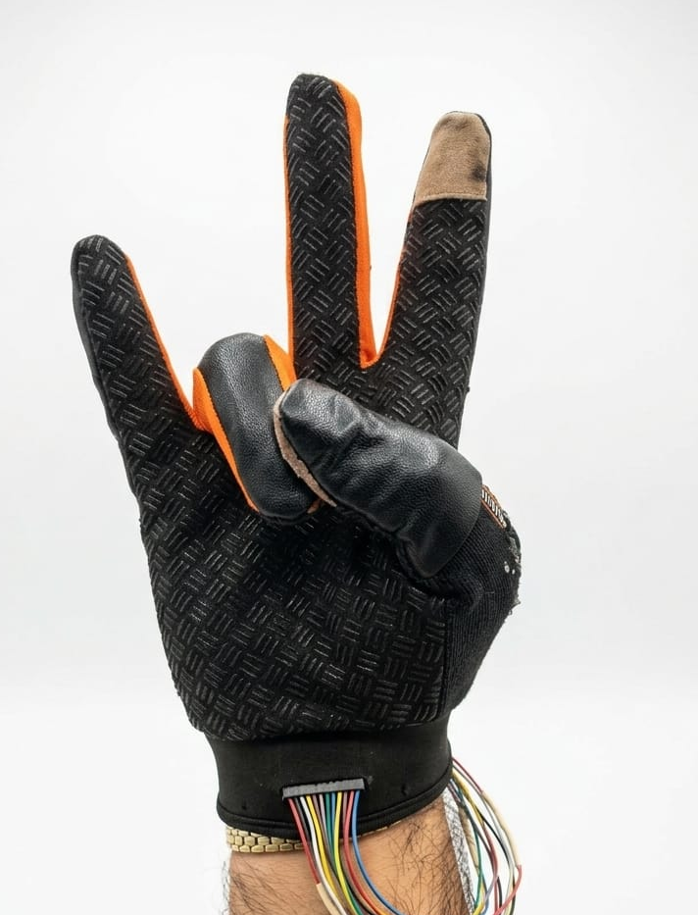
Dataset and gestures
hello
yes
no
Thank you
help

Slide 10
results
The trained model reached about 93% accuracy, showing that the prototype can recognize the selected gestures successfully.

Slide 11

Current prototype proves
Sensors reading are working
AI prediction is working
Speech output working
Gesture-to-word pipeline works

Slide 12
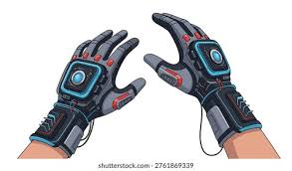
conclusion
The prototype proves that finger gestures can be detected, classified using AI, displayed on a mobile app, and converted into speech.
Future Improvements
More Gestures
Two-Glove Support
Better Sensor Mounting
On-device AI Optimization
Multilingual Speech Output

Slide 13



QUESTIONS

Slide 14
THANK YOU FOR LISTENING George ishak

